Slide 1
Compulsory Case Study 1 – The Californian Coast
The state of California has approx. 40 million people and has an economy the size of a high income country!
25 Californian counties have per capita incomes of US$ 65,000 pa – so it is one of the world’s wealthiest places!
But this means that a disaster may comprise high financial losses.
It is home to the megacities of Los Angeles, San Diego and San Francisco.
Only sophisticated management prevents California from becoming a disaster zone (in terms of mortality).
NB prediction of earthquake activity is not possible even with technology.
Parts of the population are vulnerable - around 20% of the residents in Los Angeles live below the official poverty line. These people have the lowest capacity to cope when affected by a hazard.California also has 3.5 million people (many semi-legal migrants) who live in hazardous locations.

Slide 2
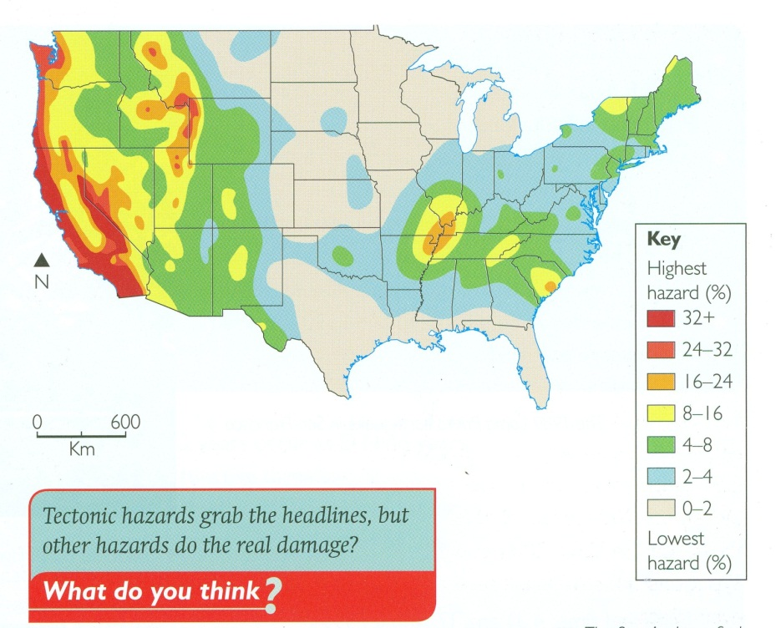
Likelihood of future hazards
Past disasters

Slide 3
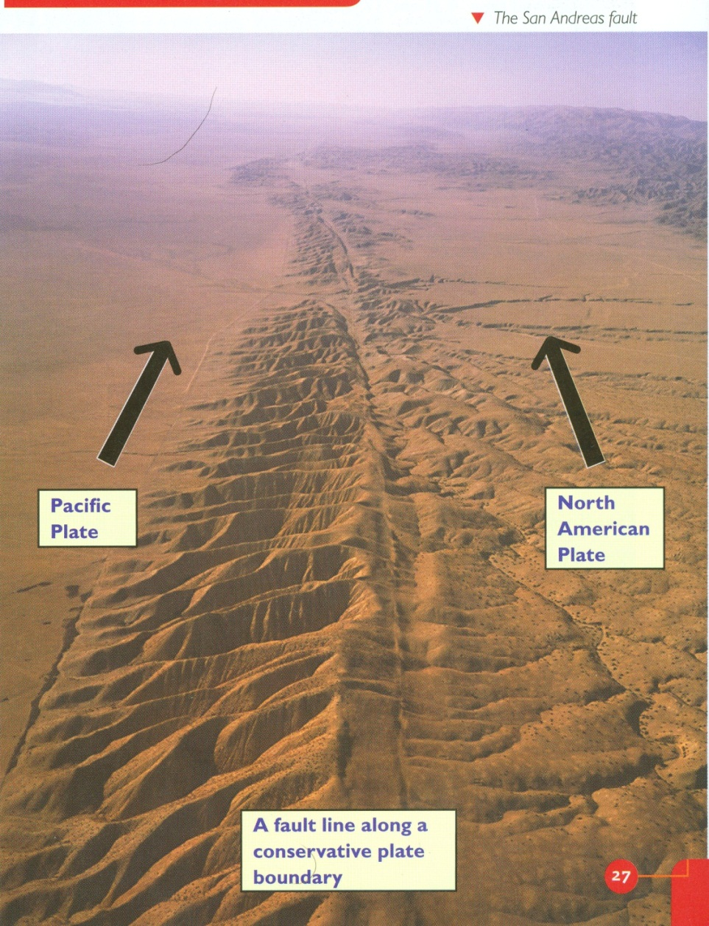

Slide 4
Geophysical hazards: Earthquakes
The San Andreas fault (part of a broader fault zone) marks a conservative plate boundary where two coastal plates slide past each other, parallel to the plate margin at differential speeds.
More than 70% of California’s population live within 50km of a fault line.
An earthquake of Richter Scale 7 or above would have massive impacts.
The soft basin sediments in LA lead to rapid shaking with 5 major earthquakes being recorded in the last 100 years.
Earthquakes are shallow and so more destructive.
San Francisco Bay has experience several large earthquakes too.
There is a lot of building on unstable land – this can lead to soil liquefaction during earthquakes (where the ground can become more like a liquid), which damages buildings and increases the risk of landslides.
This was a major problem during the Loma Prieta earthquake in 1989.

Slide 5
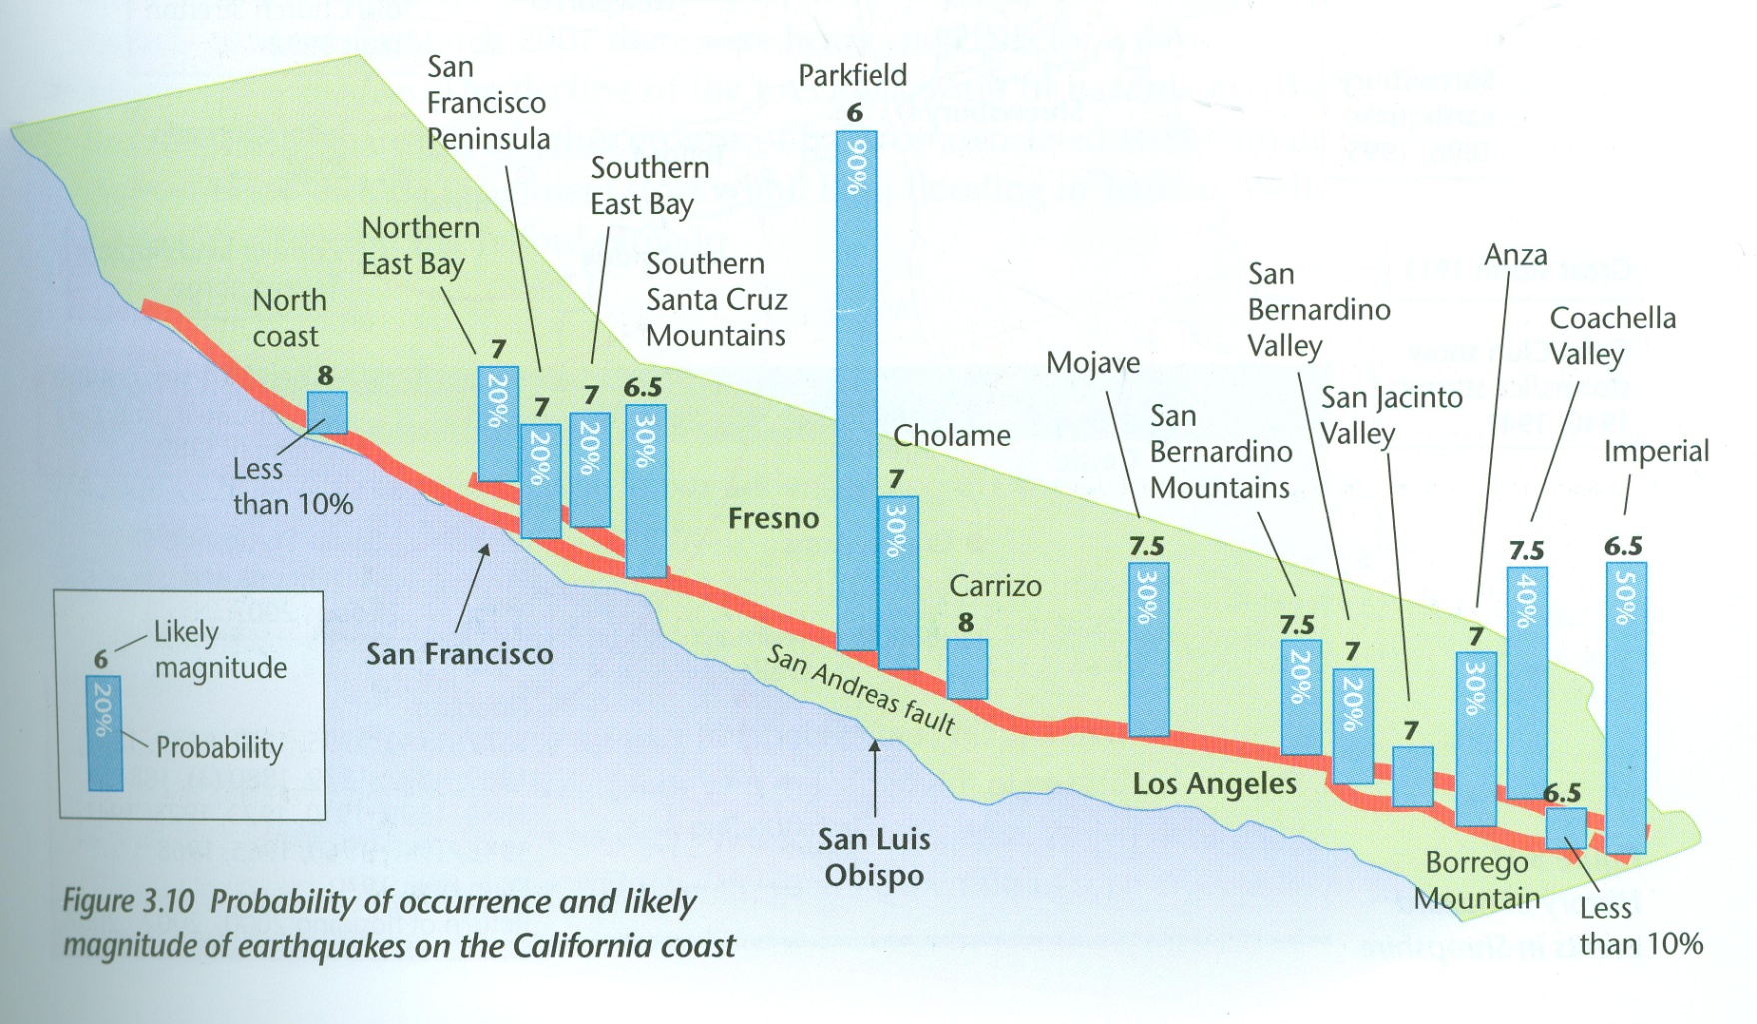
Probability of an earthquake and likely magnitude
Studies of their frequency and magnitude of past earthquakes show that there is a good chance of an earthquake of magnitude 7.0+ hitting the San Francisco Bay area before 2025.

Slide 6
Why do people live in Los Angeles despite being at risk of earthquakes?
Economic: people work in the area and can’t afford to or don’t want to lose their jobs. Well paid (£35 000 per yr) and good lifestyle.
Technology: secure that prediction methods will give them enough warning. Homes are protected and emergency services are trained.
Perception: See earthquakes as being uncommon and not a big risk. Car accidents and crime are more likely to happen so are more ‘dangerous’
Social: People have their families, friends, schools, favourite places where they live and don’t want to lose them.

Slide 7
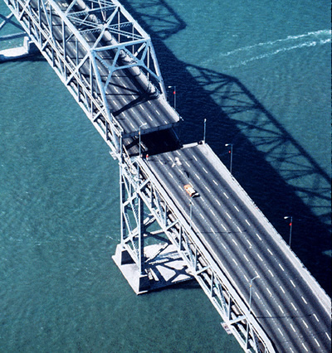
California Earthquakes
P 28 Oxford
The 1989 Loma Prieta earthquake in San Francisco
The 1994 Northridge earthquake in LA
A)What were the causes of these earthquakes?
B)What were the effects of these earthquakes?
C)How are the people of California dealing with the threat of earthquakes?

Slide 8
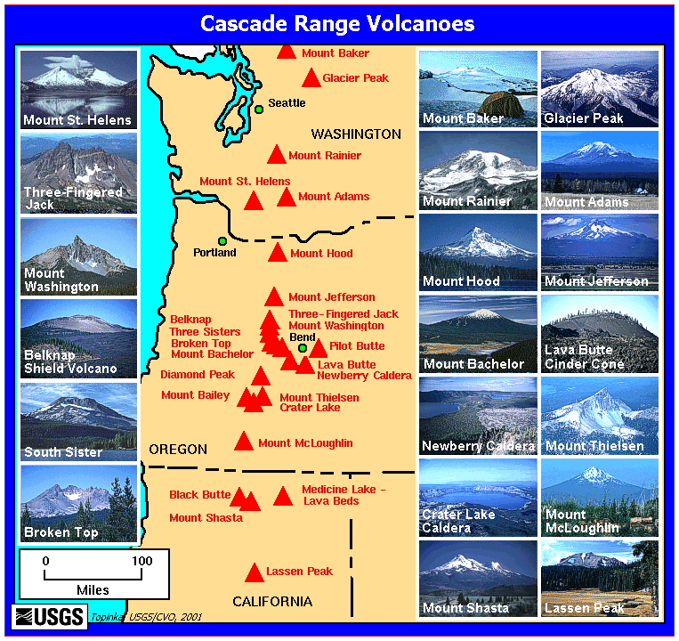
Volcanoes
There hasn’t been a volcanic eruption in California since 1915 (Lassen Peak)
But there are volcanoes being monitored for potential eruptions, e.g. Lassen Peak, Mount Shasta, and the volcanoes around Mammoth Lakes.

Slide 9
Tsunamis
A tsunami is a series of large waves that can flood coastal areas and they can be caused by earthquakes on the sea bed, or landslides into the sea.
Earthquakes under the Pacific Ocean could cause a tsunami along the California coastline.
An earthquake off the coast of Alaska in 1964 caused a tsunami to strike the coast of northern California, killing 12 people in Crescent City.

Slide 10
River flooding
El Niño La Niña oscillation: winter storms, especially during El Nino years lead to
floods in the Los Angeles and San Gabriel rivers (with deforested hill sides).
Even though rivers are now heavily channelised floods can still take place (mainly between October and January)

Slide 11
Coastal flooding
Risk of erosion along coast near Malibu and Santa Monica .
Also the area around Long Beach is subsiding and sometimes floods in heavy storms.
The impacts are likely to worsen as sea levels rise in the future.

Slide 12
Drought
Summer drought is a potential problem in a Mediterranean climate, especially in Southern California.
Droughts in California can be caused by anticyclones (long-lasting periods of high air pressure with sinking, dry air. Dry, sinking air means no rain
Drought can also be caused by La Nina events (periods when the surface water in the eastern Pacific Ocean is cooler). This means less evaporation, so there is less precipitation.
Another cause of drought is increased wind blowing westward from the desert areas that are east of California, e.g. Arizona. The dry air has no moisture to cause precipitation.
The problem is exacerbated as the population of LA is increasing so rapidly and there is a lack of water supply.

Slide 13
El Nino and El Nina in California

Slide 14
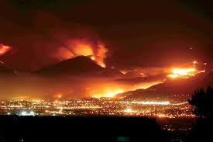
Wild fires/Bush fires
The most devastating effect of drought in California is wildfires – dry vegetation is extremely flammable, so fires spread quickly over wide areas
In the dry Santa Ana wind period there are more fires.
The wildfires in Southern California in October 2007 killed 22 people and destroyed 1300 homes.
As people move out of LA and San Francisco into the hills fires are likely to be an increasing problem.

Slide 15
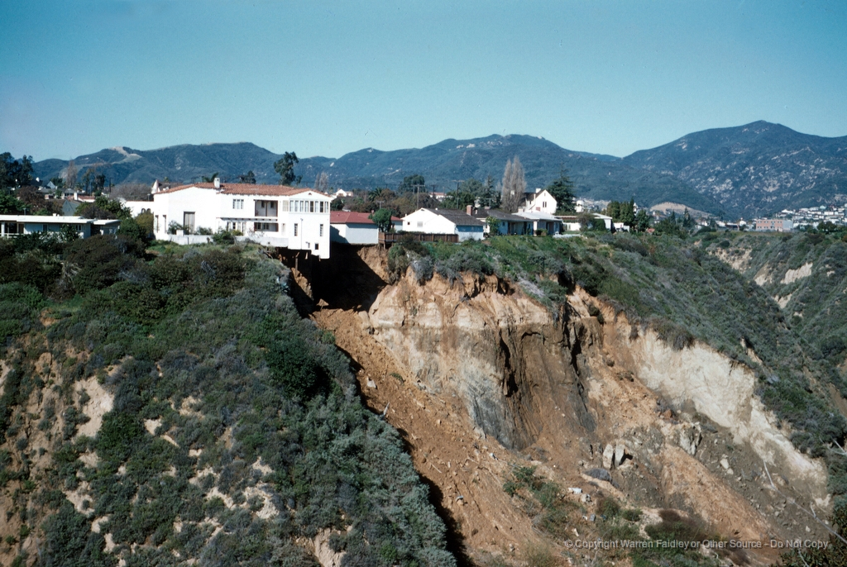
Landslides/Mudslides
The risk of landslide disasters in California is high because of building on and around steep slopes, as well as building on coastal land overlooking the ocean, E.g. La Conchita.
Landslides take place in heavy winter storms where hillsides have been burnt by wildfire
and eroded.
The risk is high along the coast near Malibu and Santa Monica.
It is a growing problem as the climate becomes more unpredictable in all coastal areas.

Slide 16
Fog/Smog
Advection fog occur when cool air from cold offshore current drifts inland and meets warm air (especially in Summer).
Climate conditions combine with car pollution to generate photochemical smog which collects in the basin.
It is especially bad in cities in late summer and autumn.

